Slide 1
FINAL PROJECT STAT 515 APPLIED STATISTICS & VISUALIZATION FOR ANALYTICS
Xiaotian Wu
Rongxin Zheng
Nadiya Nijiati

Slide 2
Agenda
Introduction
Data Source
Focusing topic
Preprocessing
Data Analysis Model and Tool
Analysis
Conclusion

Slide 3
Introduction
FOREIGN TRADE is the official source for U.S. export and import statistics and responsible for issuing regulations governing the reporting of all export shipments from the United States
Purpose: to provide goods and services shipped from the U.S. to foreign countries and shipped to the U.S. from foreign countries
Most recent status:
The Nation's international trade deficit in goods and services increased to $43.9 billion in October from $42.5 billion in September (revised), as exports decreased more than imports. (December 4, 2015)
http://www.census.gov/foreign-trade/index.html

Slide 4
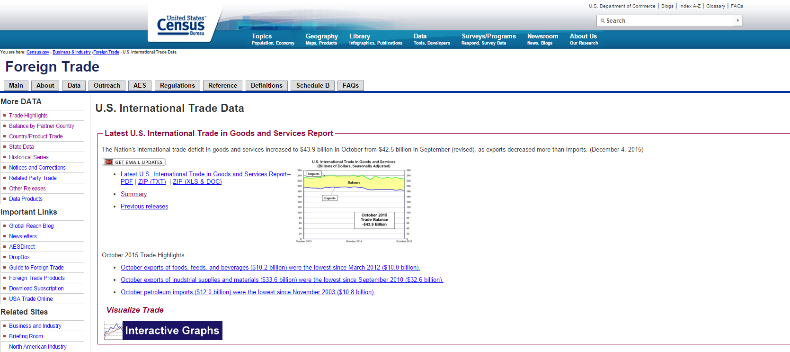
Data Source
Census.gov

Slide 5
topics
Total U.S. Exports (Origin of Movement) from Virginia - Top 25 Countries Based on 2014 Dollar Value
Real Exports of Goods by Principal End-Use Category from 1994-2015
2014 Seasonally Adjusted - Exports, Imports, and Balance of Goods by Selected Countries and Areas (focusing on Exports)

Slide 6
Preprocessing:
1. Albers equal area conic projection
1.1. In the data set of map_data, there are not Alaska, Hawaii, Puerto Rico and US Virginia Island, so I removed these data rows.
1.2. Change the State name of “Dist of Columbia” into “District of Columbia”.
1.3. Change the data form of original data files.
1.4. In the original data table, double spaces arise at the beginning of the “State” string, which made us take a long time to figure out why the column of “State” cannot match with map_data.
1.5. Encode the map theme and clean up map background.
1.6. Make an empty map using an Albers projection.
1.7. Convert the state names to lower case and merge it with map boundary file.
2. MicromapST
2.1. The package of MicromapST includes Alaska, Hawaii and D.C., so we added these data rows into data frame again.
2.2. Calculate the confidence interval.
2.3. ‘Cause the scale of data set is too large, and much of them is preprocessed manually. Therefore, we also coded a function to check whether the data is read right or not, and return a result report every running time.

Slide 7
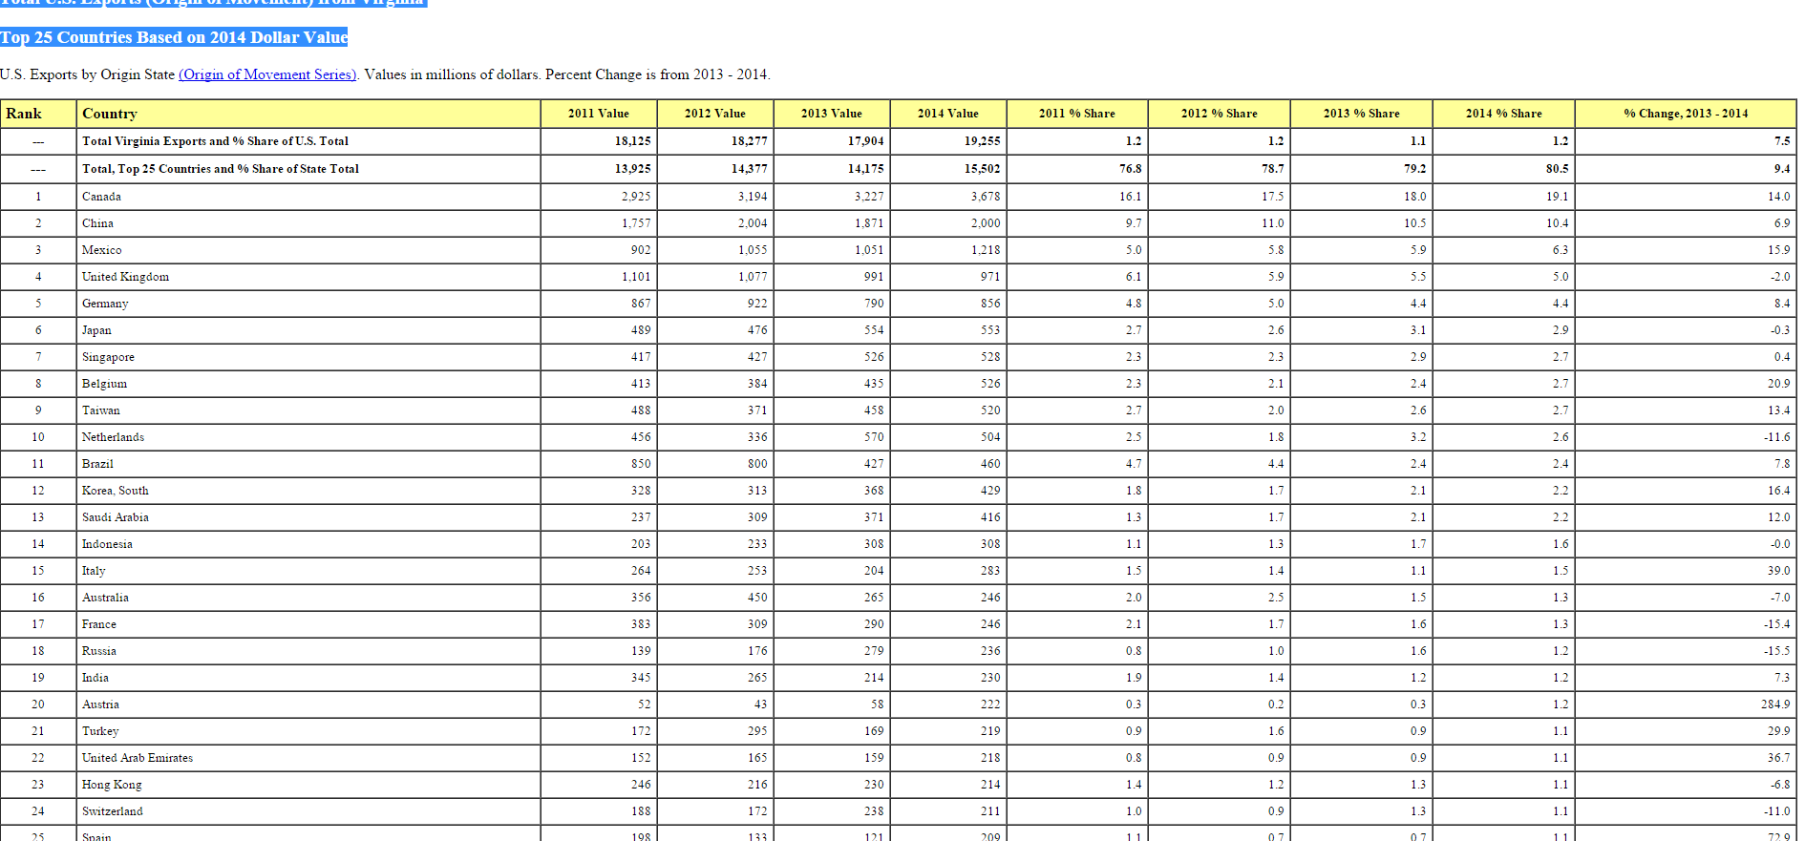
Total U.S. Exports (Origin of Movement) from Virginia - Top 25 Countries Based on 2014 Dollar Value

Slide 8
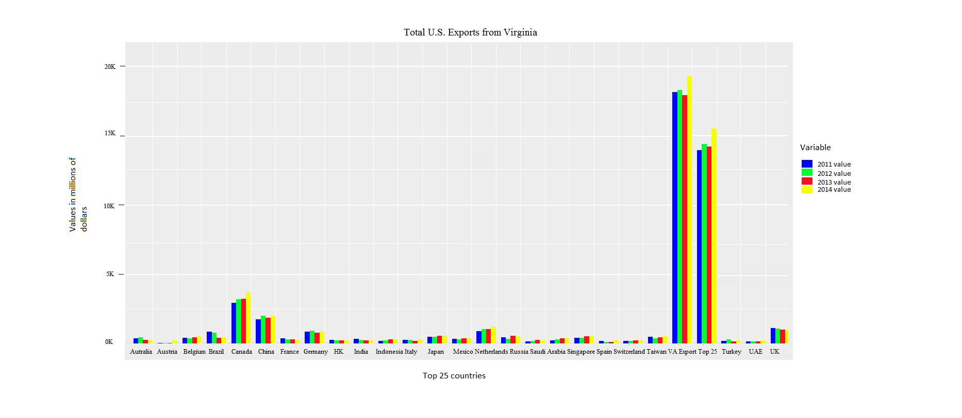

Slide 9
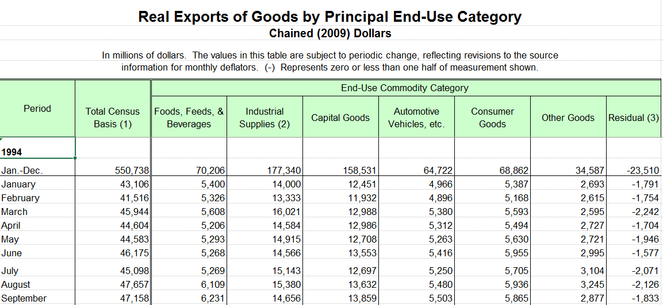
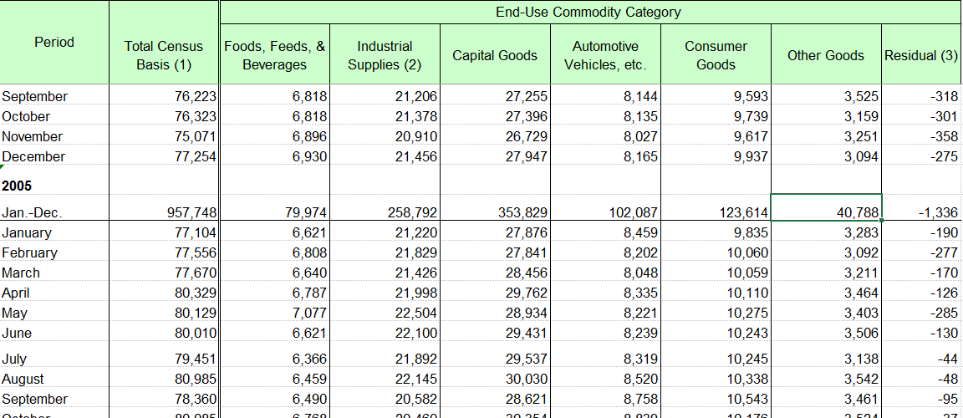
Real Exports of Goods by Principal End-Use Category from 1994-2015

Slide 10
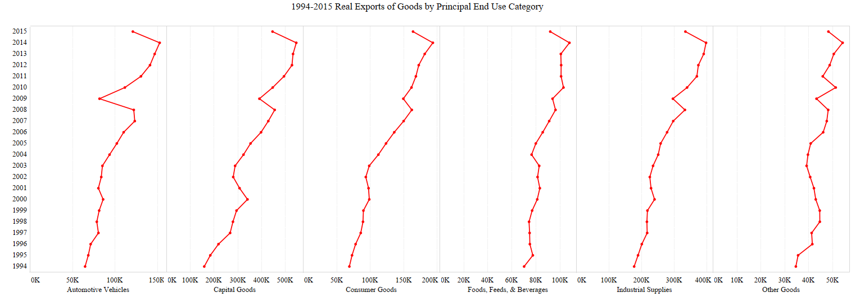

Slide 11
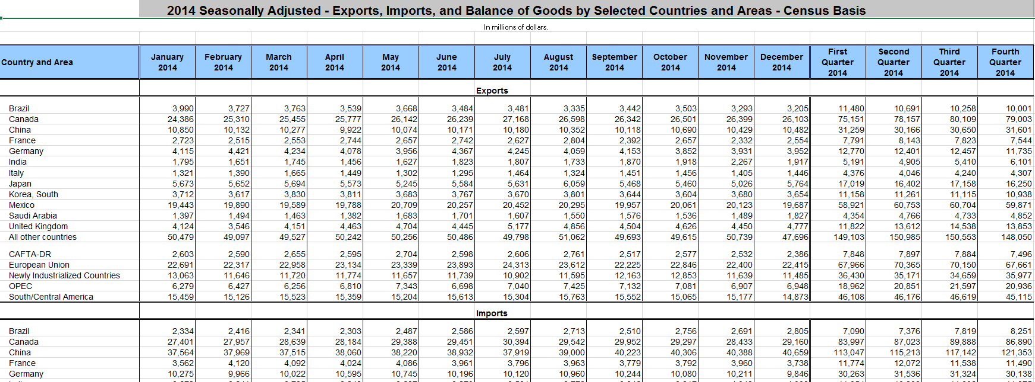
2014 Seasonally Adjusted - Exports by Selected Countries and Areas

Slide 12
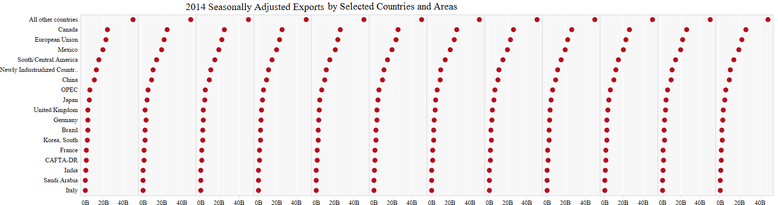
Exports

Slide 13
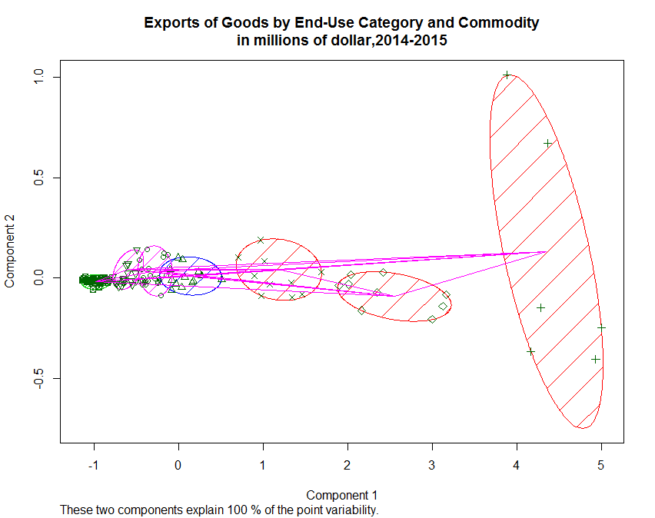
http://www.census.gov/foreign-trade/Press-Release/current_press_release/exh13.pdf
clusplot: creates a bivariate plot to visualize the clustering. The observations are represented by points in the plot

Slide 14
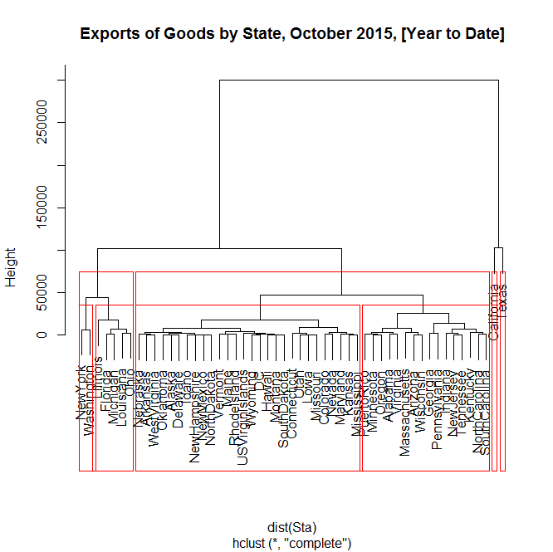
http://www.census.gov/foreign-trade/Press-Release/current_press_release/exh2s.pdf
dendrogram : clustered using Euclidean distance as the distance metric
cut trees
problem: label

Slide 15
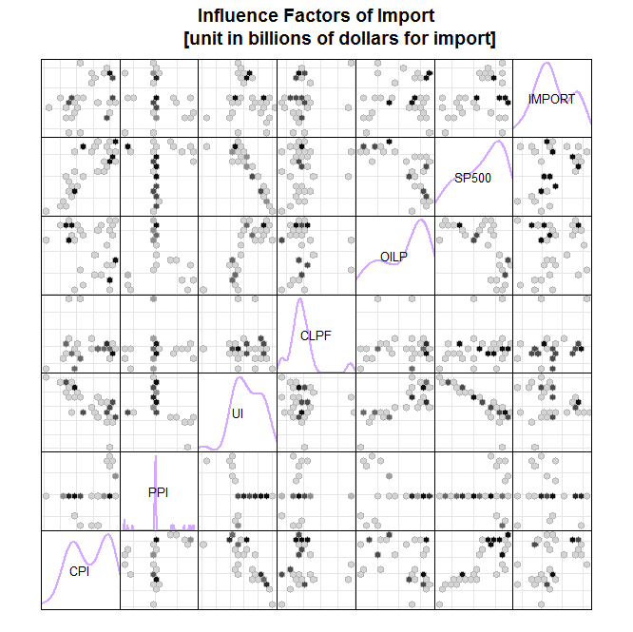
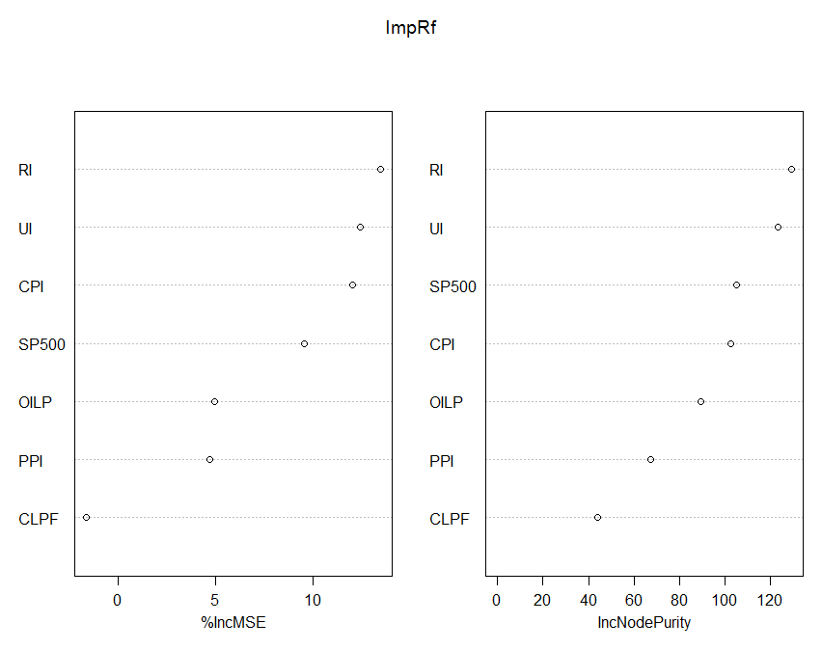

Slide 16
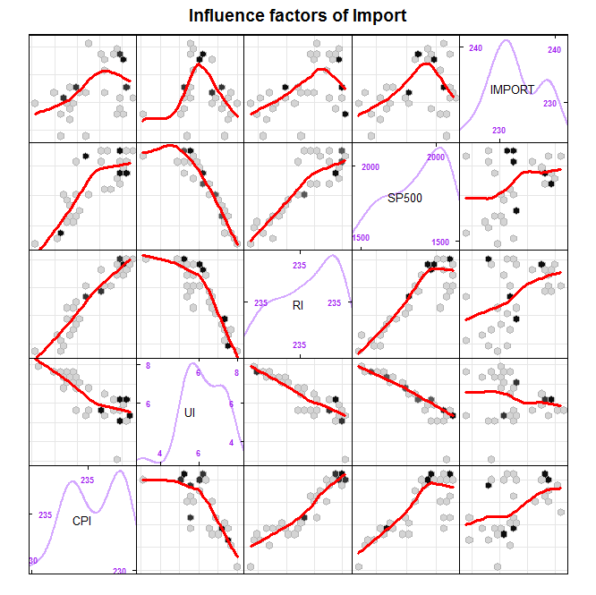
Type of random forest: regression
Number of trees: 500
No. of variables tried at each split: 2
% Var explained: 45.33
Type of random forest: regression
Number of trees: 500
No. of variables tried at each split: 1
% Var explained: 48.36

Slide 17
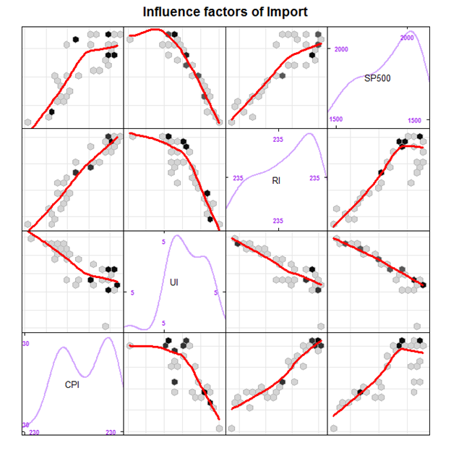
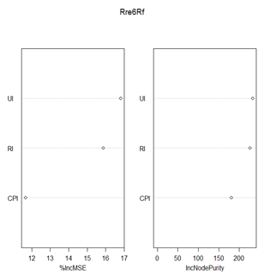
Mean of squared residuals: 3559.339
% Var explained: 90.25

Slide 18
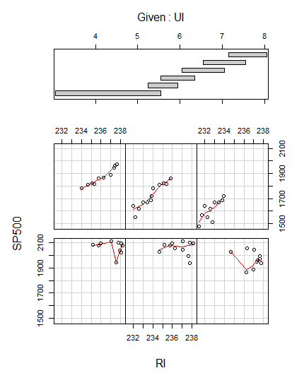


library(cluster)
colplot: the effect of a third variable in a step-by-step fashion on scatterplots of two variables together
try to explain it
Coefficients:
Estimate Std. Error t value Pr(>|t|)
(Intercept) -6171.21 2944.79 -2.096 0.044113 *
RI 36.89 11.94 3.089 0.004137 **
UI -102.89 24.64 -4.175 0.000214 ***
Residual standard error: 78.14 on 32 degrees of freedom
Multiple R-squared: 0.8471, Adjusted R-squared: 0.8376
F-statistic: 88.67 on 2 and 32 DF, p-value: 8.886e-14

Slide 19
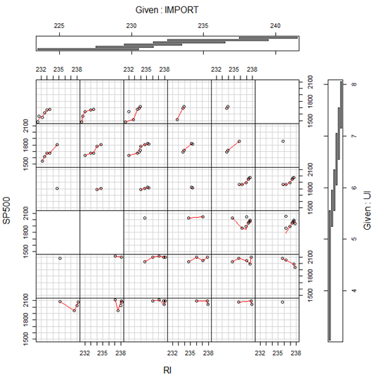
should be careful about conclusion
Residuals:
Min 1Q Median 3Q Max
-96.992 -31.451 5.846 30.777 83.179
Coefficients:
Estimate Std. Error t value Pr(>|t|)
(Intercept) 1.202e+06 6.212e+05 1.935 0.0636 .
IMPORT -5.025e+03 2.698e+03 -1.863 0.0734 .
UI -1.918e+05 9.127e+04 -2.102 0.0450 *
RI -5.127e+03 2.631e+03 -1.949 0.0618 .
IMPORT:UI 8.030e+02 3.974e+02 2.021 0.0533 .
IMPORT:RI 2.150e+01 1.143e+01 1.881 0.0708 .
UI:RI 8.202e+02 3.870e+02 2.119 0.0434 *
IMPORT:UI:RI -3.437e+00 1.685e+00 -2.039 0.0513 .
Residual standard error: 48.03 on 27 degrees of freedom
Multiple R-squared: 0.9513, Adjusted R-squared: 0.9386
F-statistic: 75.3 on 7 and 27 DF, p-value: 4.676e-16

Slide 20
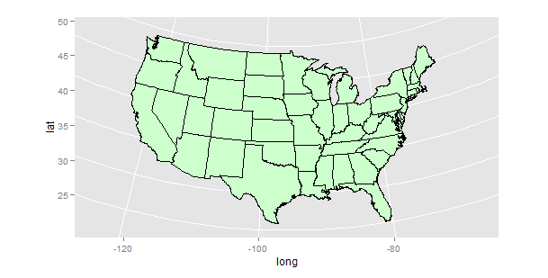
Map
1. Get map coordinates for the conterminous U.S. states and make an empty map using an Albers projection.

Slide 21
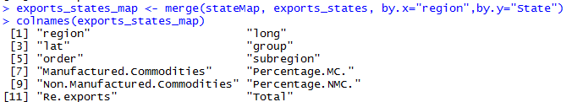
2.The data.file row.names are state names that start with a capital letter, so we converted the state names to lower case and added this in a new column, in order to match the region column of stateMap boundary file data. Then we could merge our own data frame with boundary file using lower case column.

Slide 22
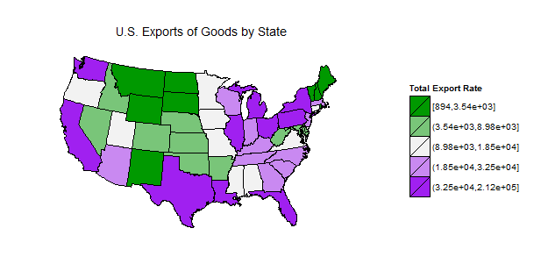
3. In order to color all the states in the map with different colors, we used the quantile function to obtain quintile classes, and sorted the states into 5 classes with roughly the 20% states falling.

Slide 23
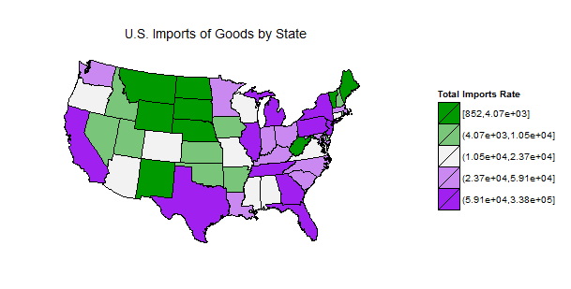
4. In the same way, we also drew choropleth map, using the data of U.S. imports of goods by States.

Slide 24
Consider
All we did above are about single map on the data frame of exports and imports. We cannot see the difference and connection through only these two plots. Somehow, assume that one rich place is supposed to have a much bigger value in imports than exports because people are so rich that they can consume more goods than people do who are living in poverty. Therefore, this time, we put the data of exports and imports together and sort them to see which of states seem relatively rich in this project.

Slide 25
5. As it said above, in the package of micromapST, the states of Alaska, Hawaii and D.C. are included, so we re-added them into the data frame. Moreover, we merged the data sets of “exports” and “imports” through “State” column, and added a new column to calculate the difference between imports and exports.
Through a panel, I exported two MicromapST plot.
(Both of them sorted by the value of “Imports-Exports”)
Combination Dots.pdf
Combination Arrows.pdf

Slide 26
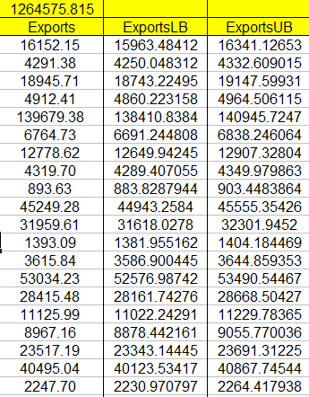
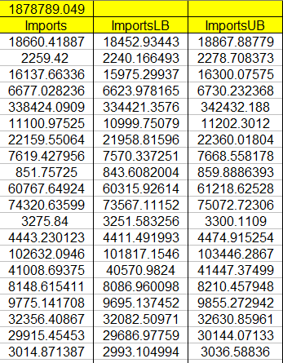
6. We used Matlab to calculate the confidence intervals of exports and imports, as shown below. Then based on this, we drew the maptail and dots with confidence intervals.
Combination of Exports and Imports DotConf

Slide 27
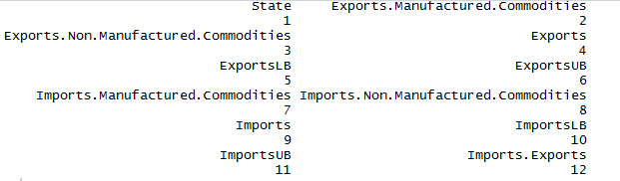
Improvement:
There are many column I preprocessed, but I didn’t use it to analyze. (like percentages, manufactured and non-manufactured goods.)
In the Albers equal area conic projection, we can add the states of Alaska, Hawaii, Puerto Rico and US Virginia Island into Map_States.
We can change the scale and limitation of axis, and set the breaks in each axis.
If the engineer add more boundary data into data. frame, then we could set the filling gradient. ‘Cause the data set is not accurate enough, and pixel is not enough either, I tried once before, but the result is blur.
We can add more boundary of other nations into data. frame, then we could also analyze other countries in that way.

Slide 28
U.S. Imports & Exports tour
https://drive.google.com/open?id=0B2BHrnedXFaxZnlXWmJuSVlaanM

